Slide 1
Ofc. Kevin Quinn
Twitter: @Officer_Quinn
Kevin.quinn@chandleraz.org

Slide 2
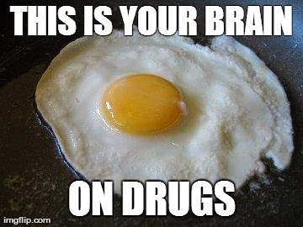

Slide 3
Be in the Know
Be knowledgeable – get educated
Can’t talk to your kids if you don’t know what to say
Tell others: friends, neighbors, golf partner, co-workers, sister, etc.
Take action… learn and react
Recognize signs and symptoms… Don’t ignore!
Ask questions – start conversations
Properly dispose of medications at community sites
Show/tell others what to do and where

Slide 4
The Rule of 5
5 years of age
This is the average age experts advise you should start having the drug talk
5 year plan
How old is your kid? What do you want them to know 5 years from now?
Start talking

Slide 5
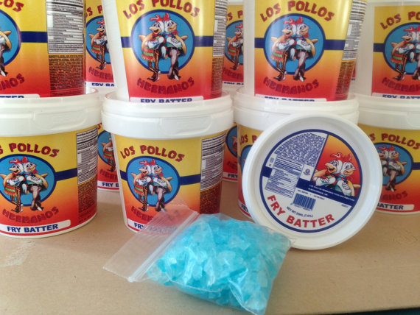
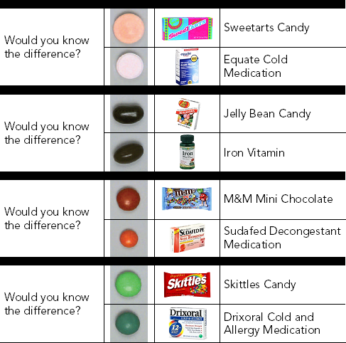
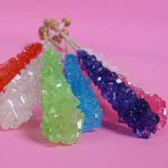
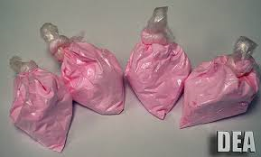
Drugs look like candy You never know what you are getting
Los Pollos Hermanos Meth (Candy) Buckets
Flavored Cocaine

Slide 6
Love this Life
Commit to long term planning
Friday is not long term planning
What do you want to do? Where do you want to go?
Take the lead
Be strong, independent, confident… do what matters
Make decisions now for later
Choose wisely
Know your choices impact others
… and your future
Reduce your risks and…
Extend your opportunity of life

Slide 7
“Teens' behavior is strongly associated with their parents' behavior and expectations, so parents who expect their children to drink and use drugs will have children who drink and use drugs."
Joseph A. Califano, Jr., CASA's chairman and founder and former U.S. Secretary of Health, Education, and Welfare

Slide 8
12.5
Average age to start experimenting with
drugs and alcohol

Slide 9
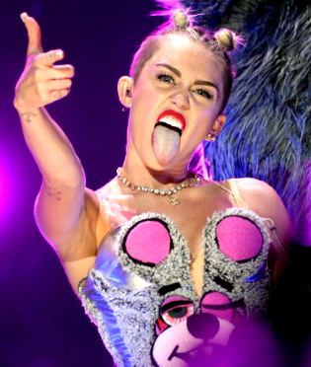
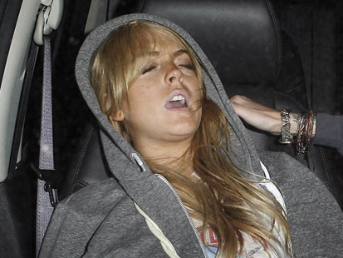
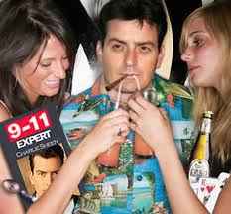
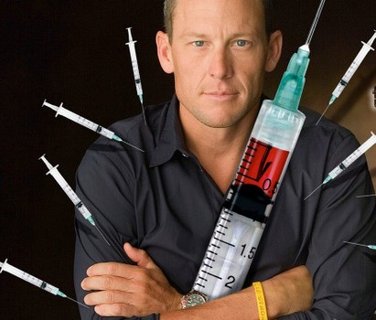
Social Norms in the Media
Failed drug test…again
I was banging 7 gram rocks and finishing them! That’s how I roll!

Slide 10
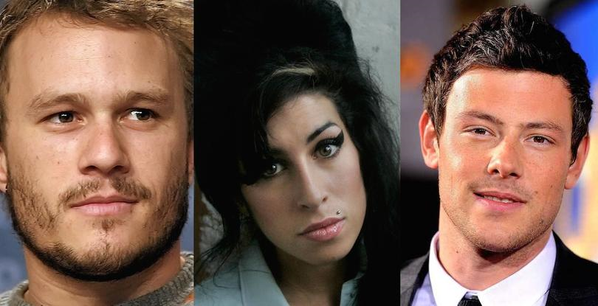
Some don’t make it though…

Slide 11
Push ‘em toward their PASSION
#1 Reason teens use drugs…
Boredom
What are you passionate about?
Sports/Fitness – team, classes, 5K
Dancing – classes, fun, events
Pets – rescue, shelters, volunteer, vetinarian
Music – singing, listening
Reading – for fun, as a volunteer
Writing – songs, poetry, books
Teaching – any classes
Art – are the creative? Photography, drawing, painting
Computers – games, social media, websites

Slide 12
Roles models help define Norms Where the norms come from are IMPORTANT
Parents
Teachers
Grandparents
Music instructor
Counselors
Sports coaches
Positive Peer – after school program
Neighbors
Aunts/Uncles
Pastors
SROs
Youth group leaders
Bosses
Important adults

Slide 13
Prevalent Drugs of Abuse:
Alcohol
Cigarettes
Marijuana
* Prescription Drugs
Source: Monitoring the Future Survey, Institute for Social Research, University of Michigan, 1999.

Slide 14
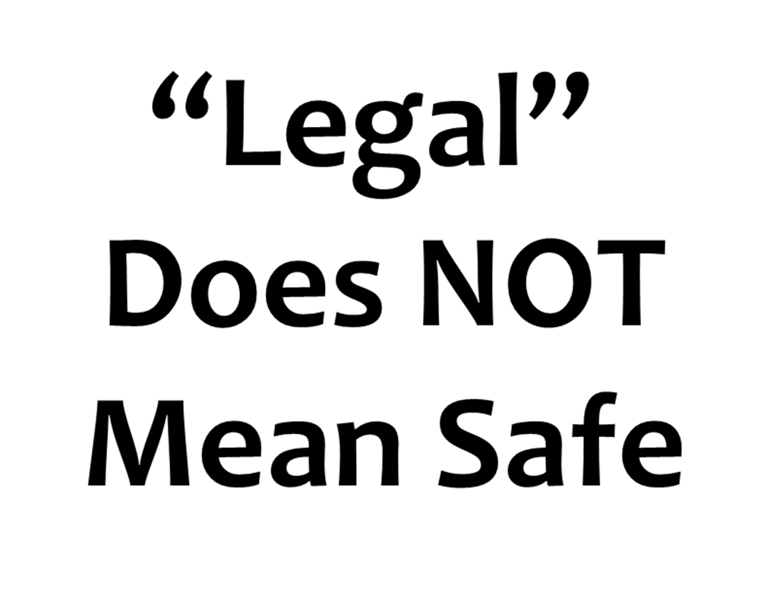

Slide 15
Electronic Nicotine Delivery Systems (ENDS)
Vaporizers, vape pens, hookah pens, electronic cigarettes, e-pipes, etc.

Slide 16
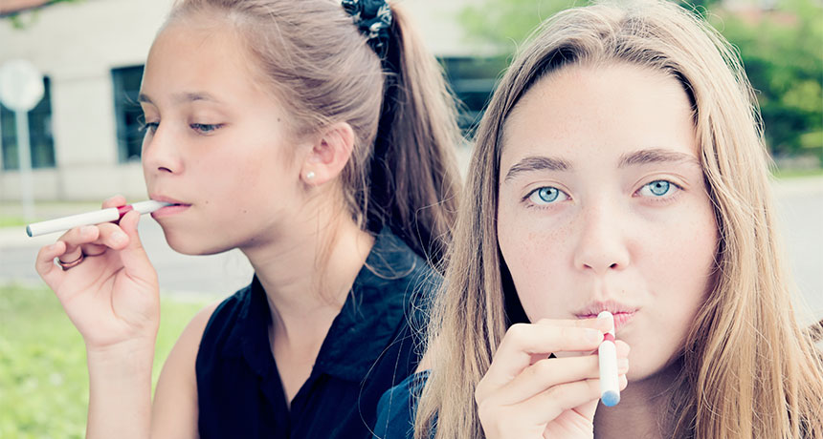
E-cig use and teens
Use among middle and high school students tripled from 2013-2014
High School
4.5% to 13.4%
660,000 – 2 million
Middle School
1.1% to 3.9%
120,000 – 450,000

Slide 17
ENDS and Teen Use
More than 3 million middle and high school students were current users of e-cigs in 2015
In 2014, 81% of current youth e-cig users cited the availability of appealing flavors as primary reason for use
How do they obtain:
Visa Gift Cards Amazon Account = Purchase

Slide 18
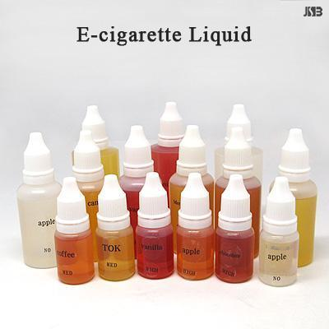
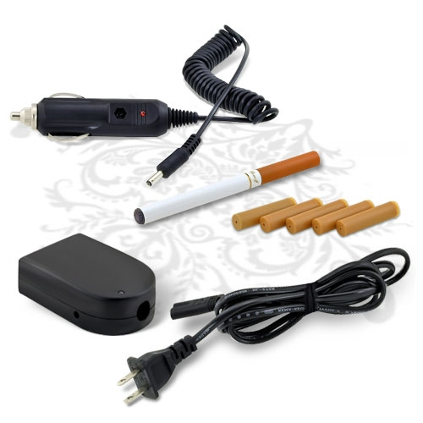
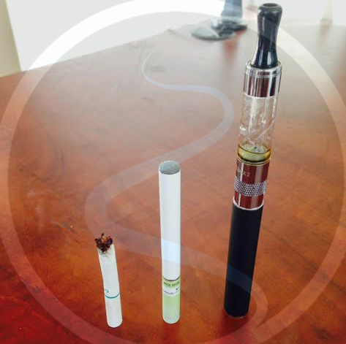
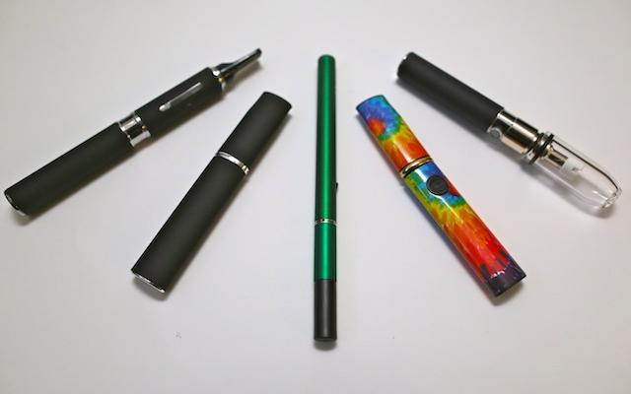
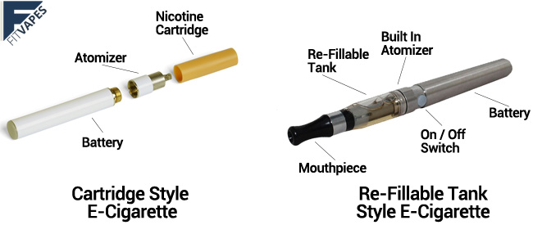
What does it look like?
Vaping pens
Regular Cigarettes, Electronic Cigarettes, Vaporizer Pens

Slide 19
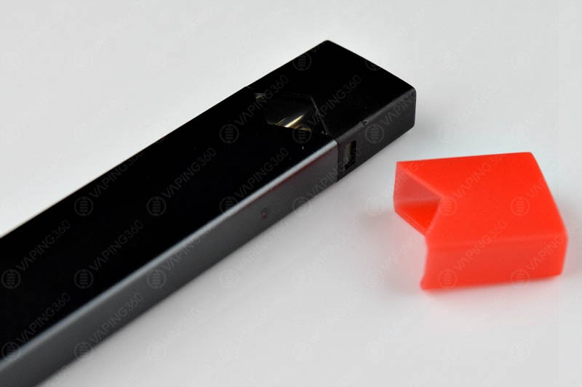
JUUL “Juuling” #JUULVAPOR

Slide 20
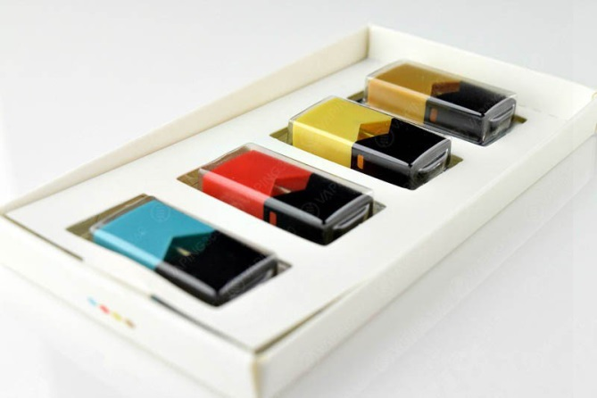
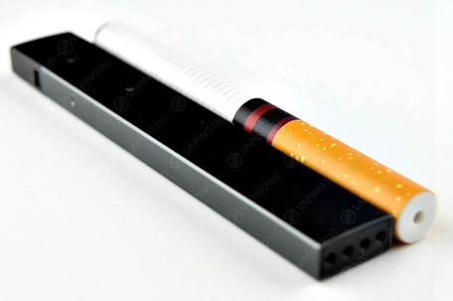
Juul Vapor e-cigarette
The Juul is barely 9cm long and 1.5cm in width. It’s basically the size of a long USB stick and weighs about the same! Ideal for putting in your pocket and taking around with you.
4 different flavor pods that are easily inserted into the device. You get 4 pods: Miint, Fruut, Bruule and Tabaac. You also get a magnetic USB charging device and a 1 year warranty.
Each Juul pod flavor cartridge contains 0.7mL of juice with 5% nicotine by weight.
The total prize for the kit is $49.99.

Slide 21
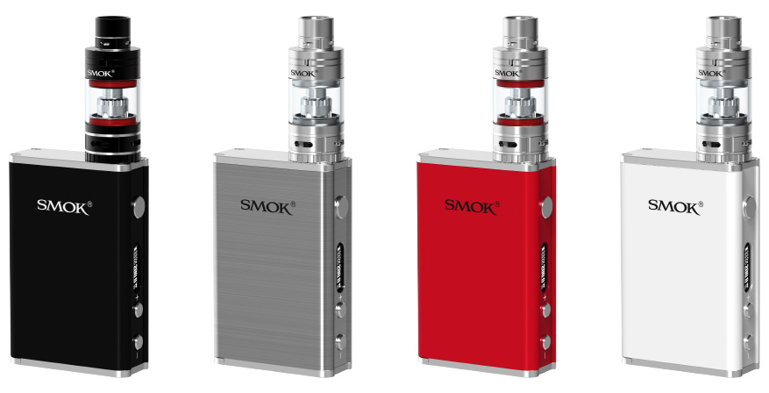
Mods “Modding”
They have more features than regular e-cigarettes, customizable options, long battery life, and most importantly, they produce more vapor
“Modifying” them to accommodate larger batteries and higher resistance atomizers, and better cartridges and tanks

Slide 22
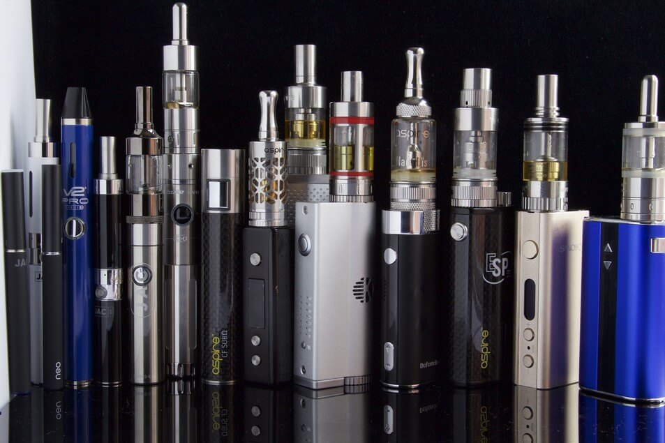
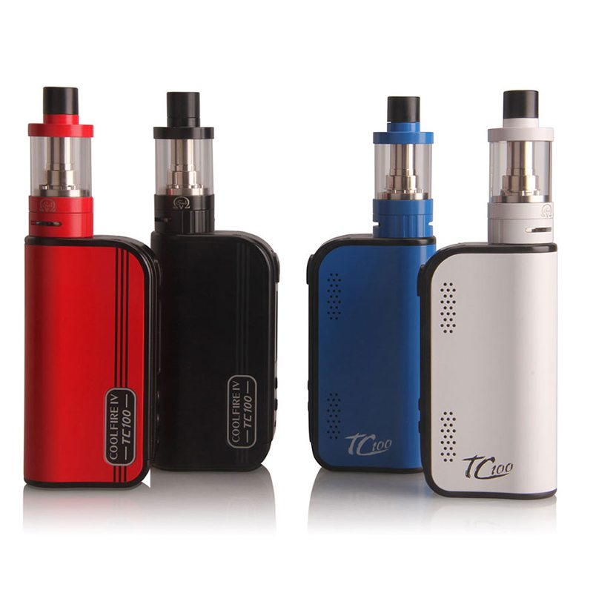
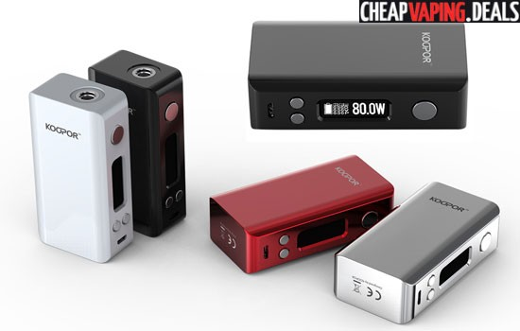
More Mods

Slide 23
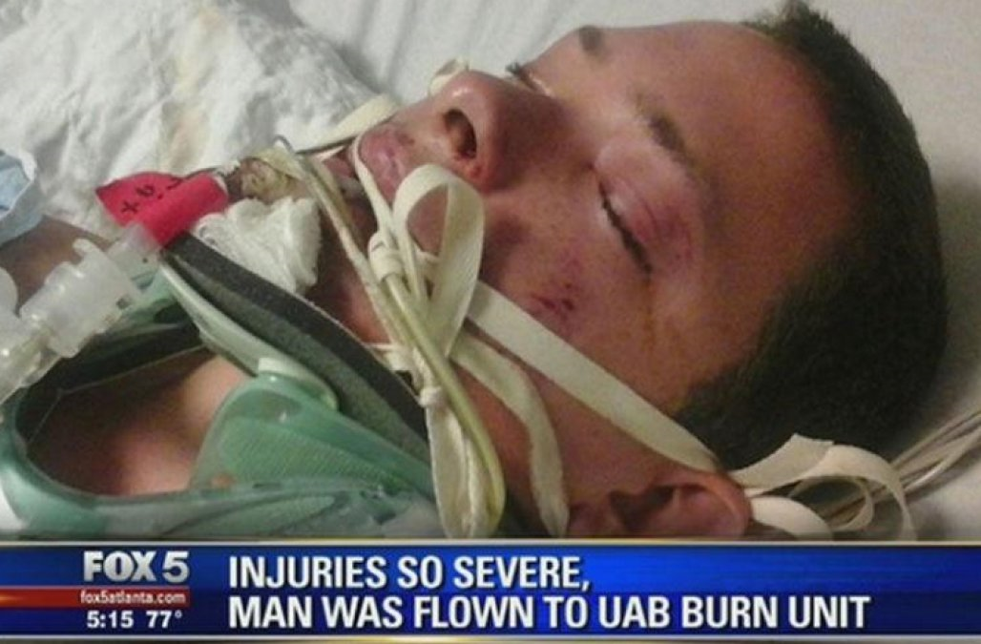
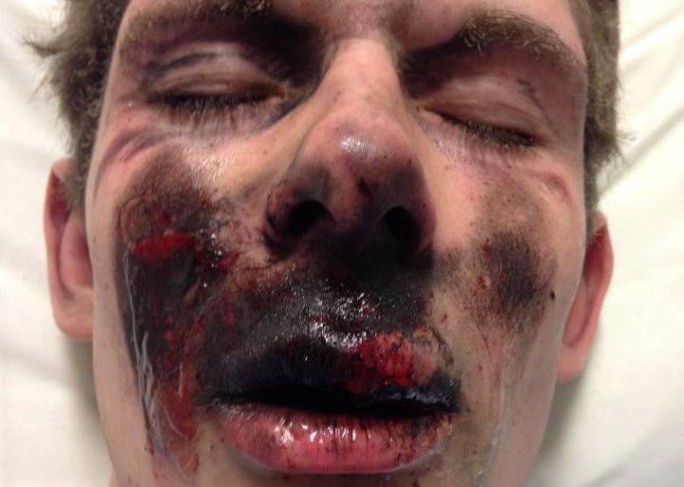
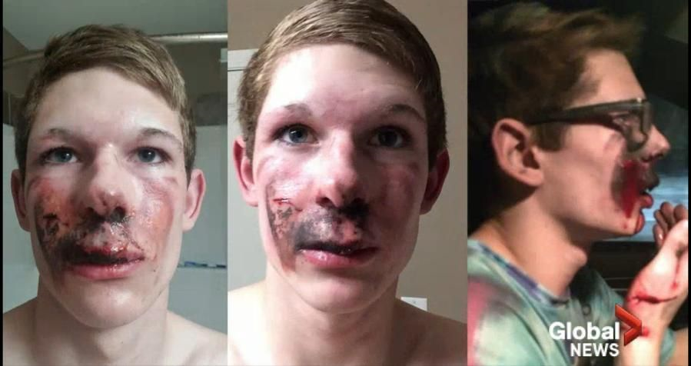
E-cig explosions
16 year old teen suffers 2nd degree burns to face

Slide 24
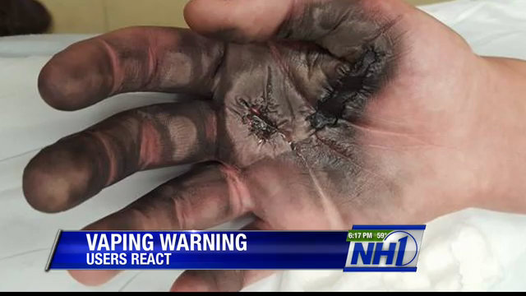
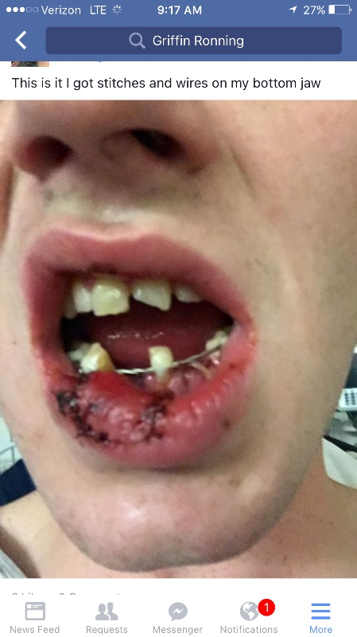
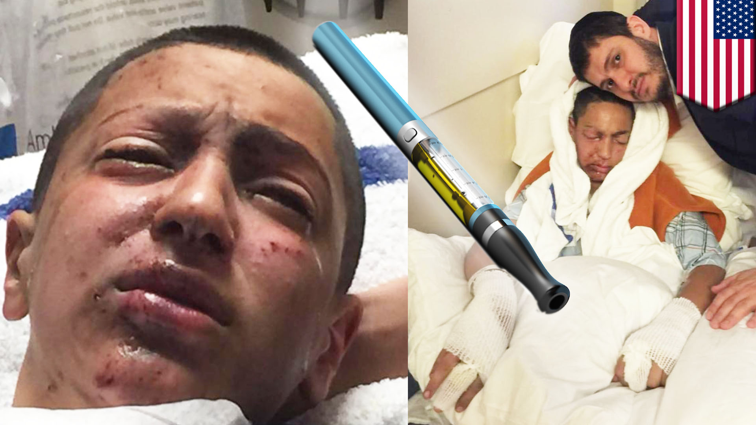
Teens and Vape explosions

Slide 25
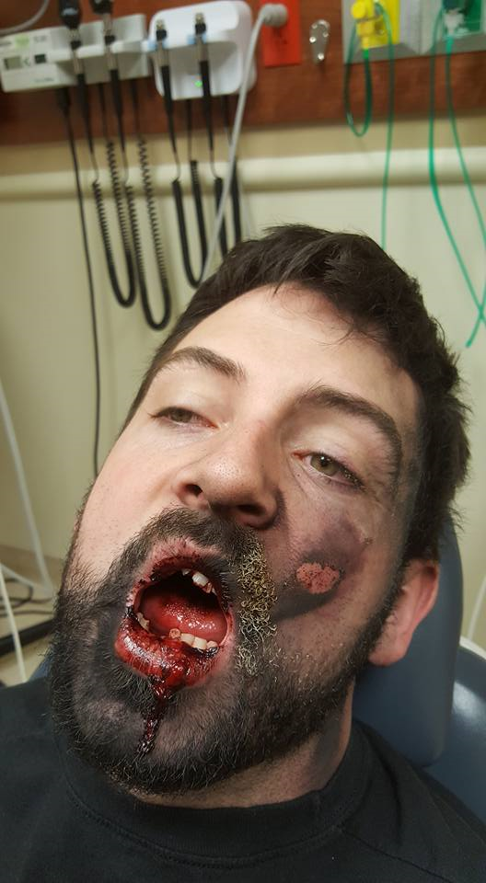
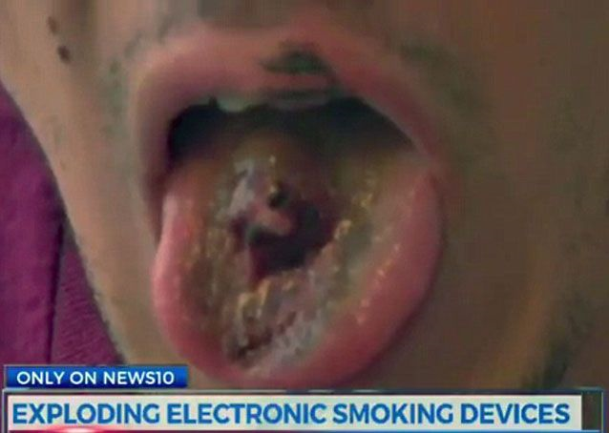
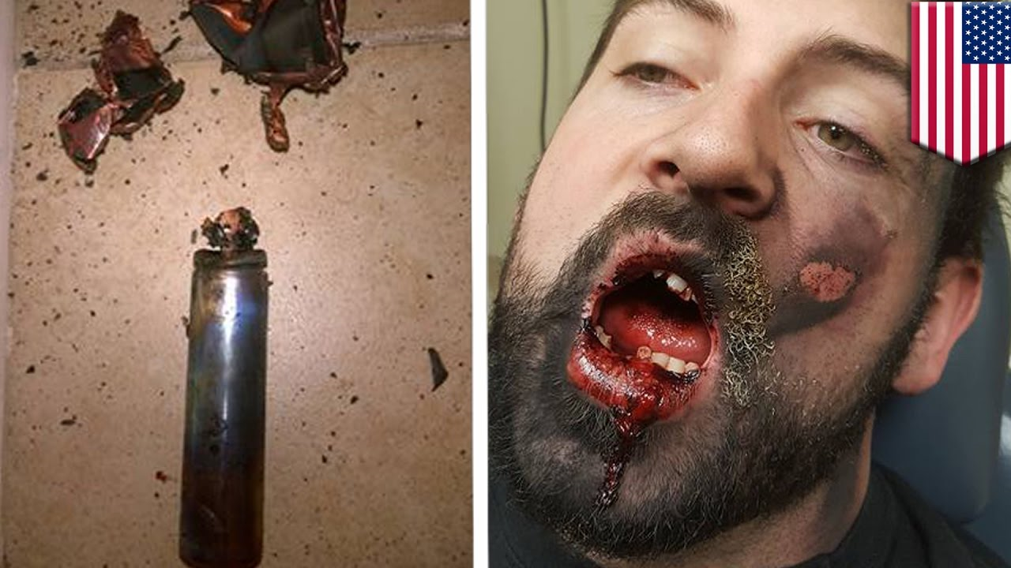
Man loses 7 teeth after vaping explosion
Man loses part of tongue after vaping explosion

Slide 26
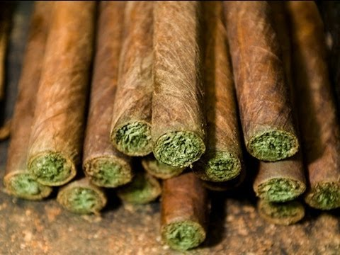
Then
1960-1970s – 2-3% THC (leafy green)
420 (chemicals, time to smoke, date to party)
Smoked weed

Slide 27
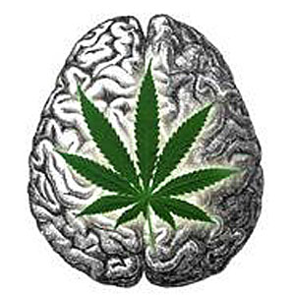
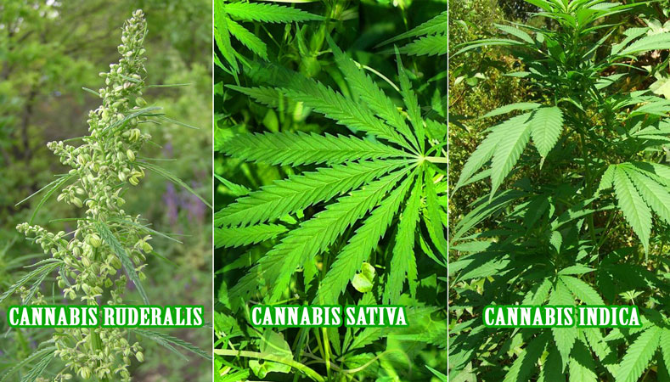
Now
20-30% THC (leafy green)
710 (oil, concentrated w more chemicals)
Vaped, smoked, edible, dabbing
Might not smell it
Looks like butter, honey, oil
Synthetic: cooked with butane
90% THC
Psychotic breaks
Violent behaviors

Slide 28
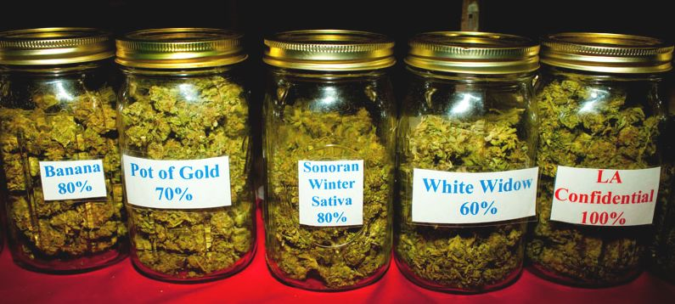
THC
Tetrahydrocannabinol
Psychoactive ingredient in marijuana (high)
Can cause paranoia or anxiety
Mind altering
Induce sleepiness

Slide 29
What’s happening in states with legalized marijuana?
Colorado now has the highest use rate of marijuana in the nation. Teen illicit use is 74% higher in Colorado than the national average—a 20% increase since 2012. (2015 SAMHSA Report)
Increase in marijuana-related traffic fatalities, hospitalizations, and emergency room visits as well as marijuana- related calls to poison control centers. (Rocky Mountain HIDTA)
In marijuana-friendly states, accidental ingestion by youth is up over 600 percent. (Journal of Clinical Pediatrics)
Black market is thriving, hiding in plain sight in Colorado. A recent AP report says: “Illegal drug traffickers are growing weed among [Colorado’s] sanctioned pot warehouses and farms, then covertly shipping it elsewhere and pocketing millions of dollars from the sale.” (AP Jan. 2016)

Slide 30
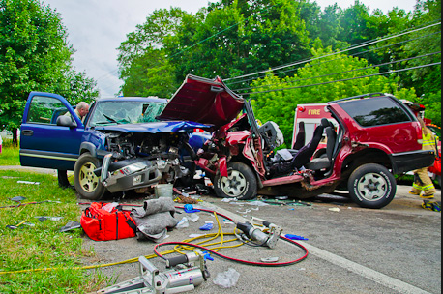
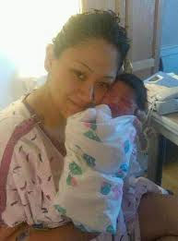
Colorado State Patrol
77% of total DUID involve Marijuana
41% of DUID involve Marijuana ONLY
Tanya Guevara & Baby, killed by marijuana impaired driver

Slide 31
Rx Drug Use – An Epidemic
“Prescription drug abuse is the nation's fastest-growing drug problem”
White House Office on National Drug Policy
1.3 million emergency room visits in 2010, a 115% increase since 2004
Overdose deaths on opioid pain relievers surpassed deaths from heroin and cocaine for the first time in 2008

Slide 32
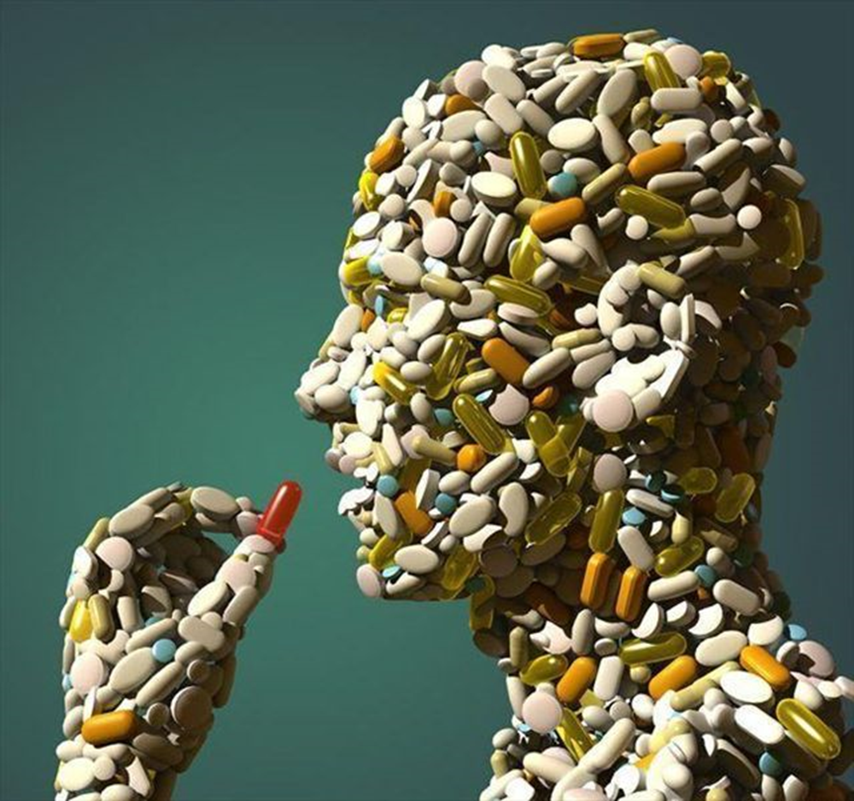
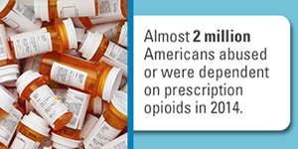
US loves Rx

Slide 33
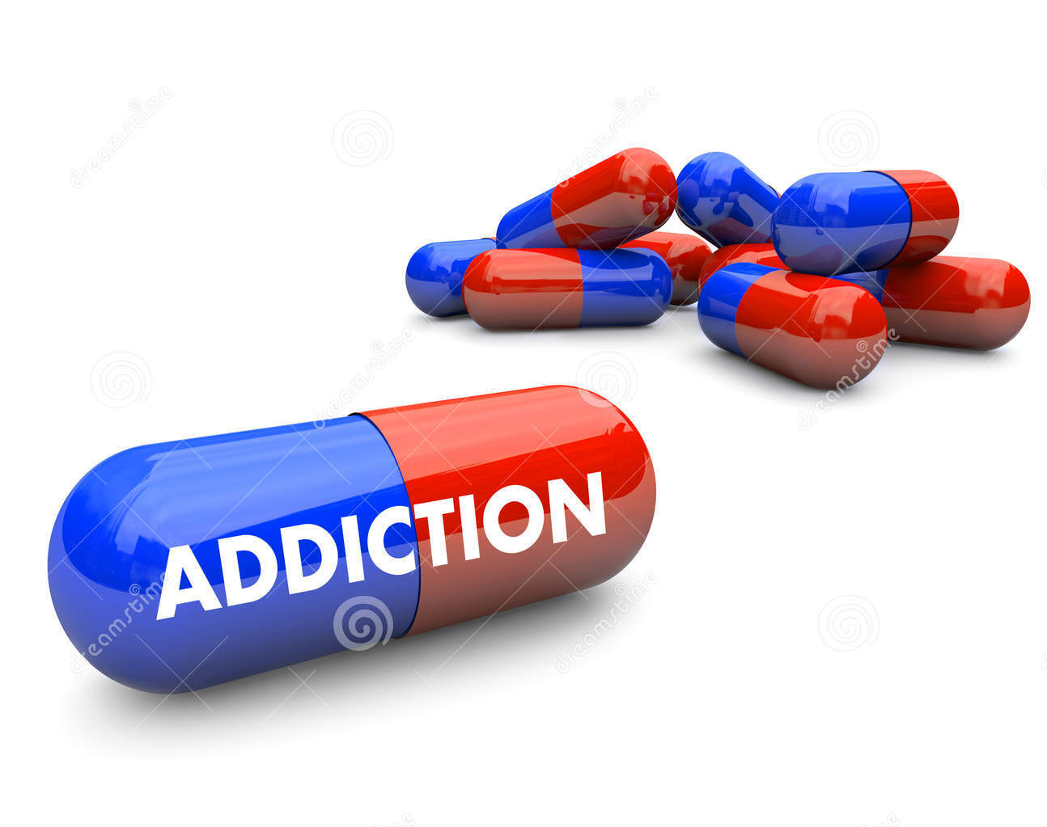
Rx by the #s
As many as 1 in 4 people who receive prescription opioids long term for non-cancer pain in primary care settings struggles with addiction
Every day, over 1,000 people are treated in emergency departments for misusing prescription opioids

Slide 34
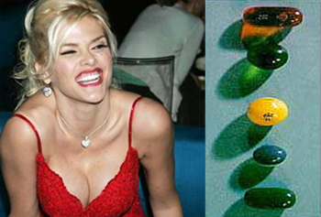
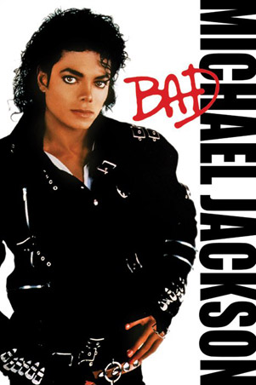
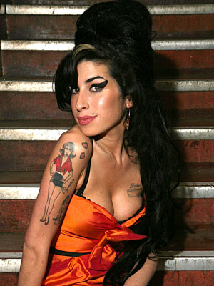
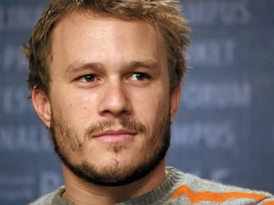
Accidental Rx Overdoses

